Slide 1

Unlocking Consumer Trends: Insights Into Black Friday Sales
Analyzing Socioeconomic Factors in Consumer Behavior
By: Thasin Wahid, Jairo Onate, Mazen Alhaffar

Slide 2
Introduction
Understanding consumer behavior is essential for businesses.
Focus on socioeconomic variables like gender, occupation, and marital status.
Objective: Optimize marketing strategies and boost profitability.

Slide 3
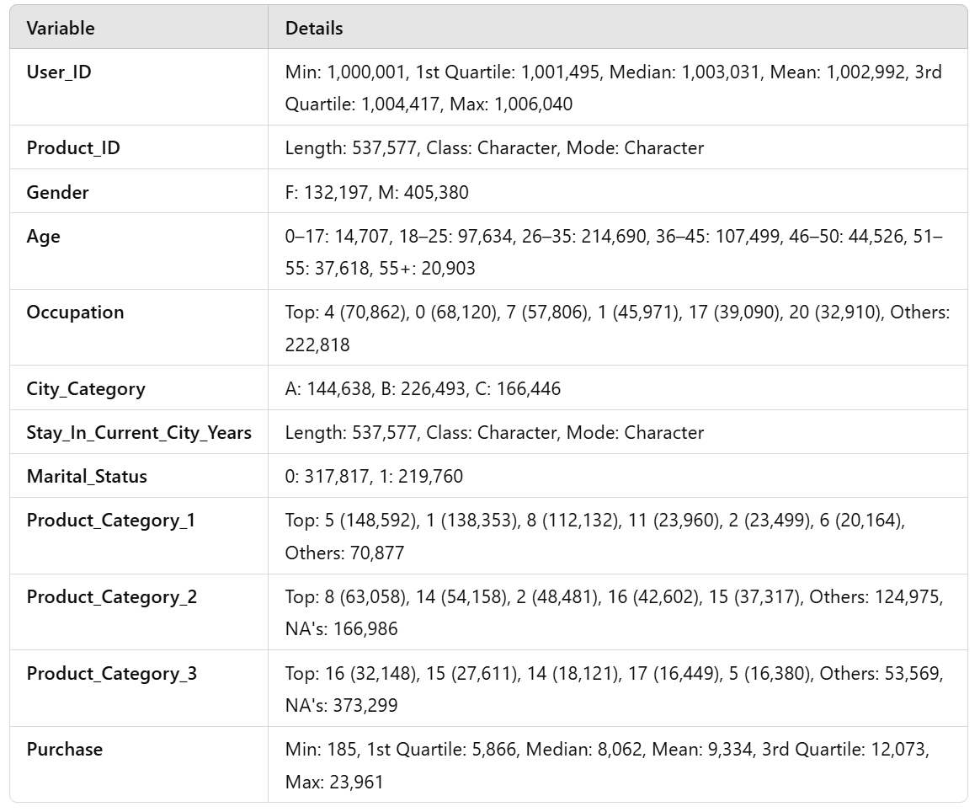
Summary Statistics
The dataset contains 537,577 entries, with a majority of users aged 26–35 years (214,690) and predominantly male (405,380).
Users are distributed across cities B (226,493), C (166,446), and A (144,638), with the top occupation being 4 (70,862 users).
Purchases range from 185 to 23,961, with a median of 8,062, and Product_Category_1 (5) is the most purchased (148,592 times).

Slide 4

Challenges and Limitations
Predictive model struggles with high-value purchases
Aggregated data may mask regional and nuanced trends
Future improvements: Incorporate observational data

Slide 5
Model Results
The model explains approximately 49.4% of the variance in purchased amounts (Adjusted R² = 0.4941), indicating a moderate fit with statistically significant results (F-Statistic at p < 2.2e-16)
Interaction terms between Occupation and City Category highlight nuanced patterns in how demographic and geographic factors jointly affect purchases
Multiple significant predictors such as age groups (18–25, 51–55), occupations (e.g., Occupations 5, 6, and 20), city categories (C), and product categories (12, 13, 14) greatly influences purchase behavior

Slide 6
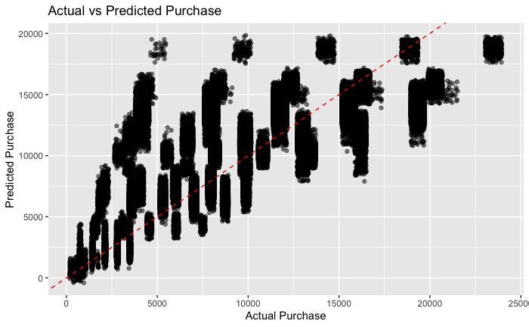
Model Performance Insights
Predictive model performs well for low to mid-range purchases
Limitations in predicting high purchase values
Key takeaway: High purchase values need better refinement

Slide 7
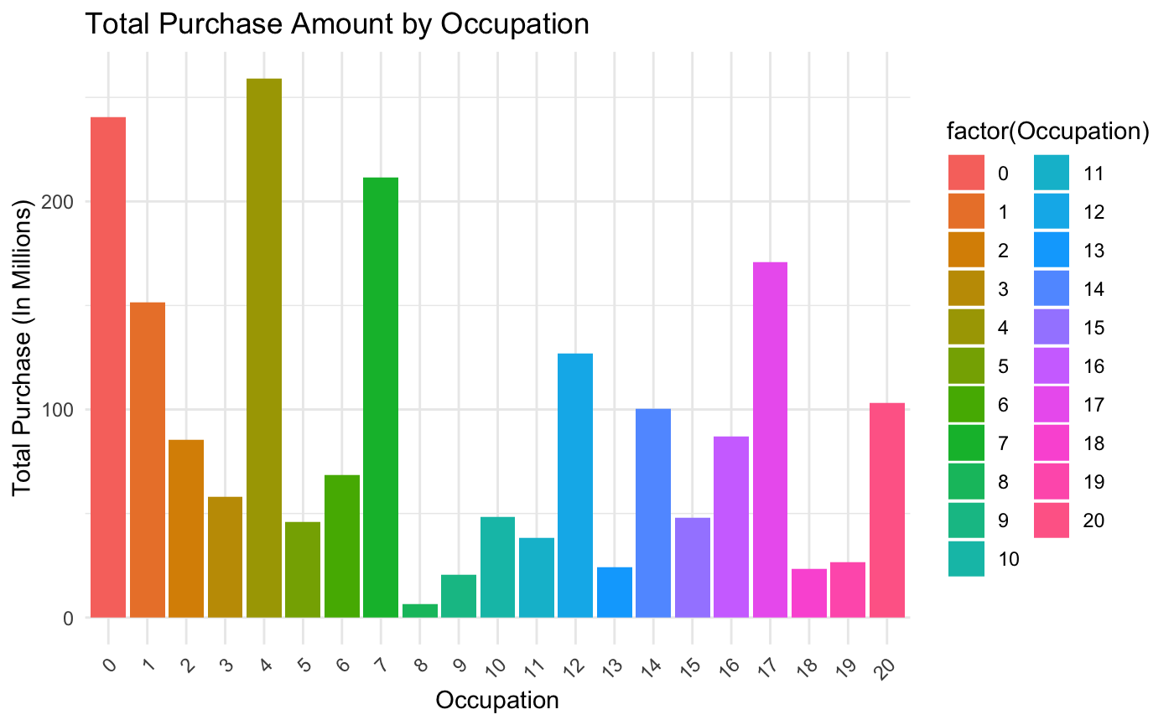
Occupation Analysis
Significant variations in purchase amounts across occupations
Occupation groups 0, 4, 7, and 17 are high contributors
Target these groups for focused marketing strategies

Slide 8
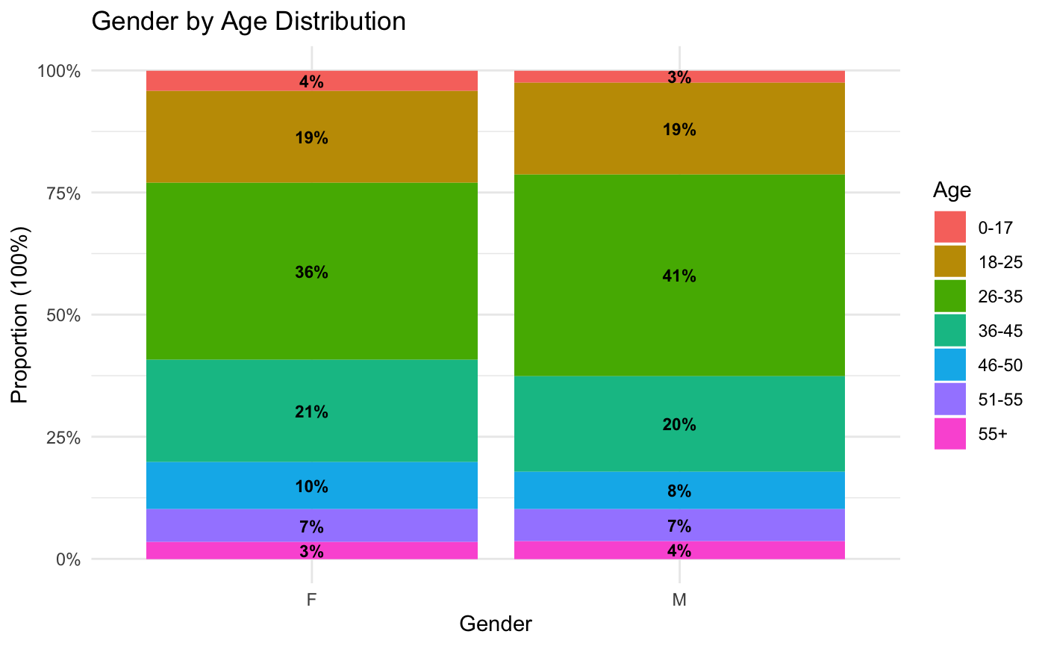

Age and Gender Distribution
26–35 age group is the largest segment
Gender distribution is similar across all age groups
Focus promotions on middle-aged adults

Slide 9

Consumer Preferences
Popular categories include electronics and clothing
Align promotional strategies with consumer preferences
Ensure availability of high-demand products

Slide 10
Conclusion and Recommendations
Key insights: age, occupation, and gender influence buying patterns
Target middle-aged adults and high-spending occupations
Use data-driven strategies to maximize Black Friday sales

